Slide 1

Handling Errors and Debugging in React Native
Welcome to our comprehensive guide on handling errors and debugging in React Native development. This presentation will equip you with essential skills to identify, manage, and resolve common error types while implementing effective debugging strategies.
By the end of this presentation, you'll understand the critical importance of error handling for application stability, learn techniques to manage various error types, and discover powerful debugging tools that will streamline your development process.

Slide 2
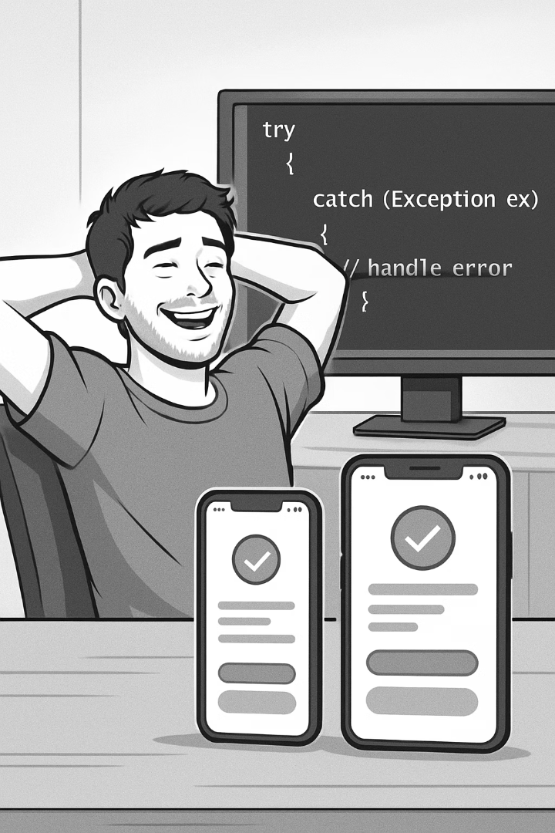




Why Error Handling Matters
Prevents App Crashes
Catching and managing errors prevents crashes and ensures users can continue using the app, even when issues occur.
Improves User Experience
Proper error handling keeps users unaware of internal errors, avoiding unresponsive screens, abrupt exits, or incomplete operations that lead to frustration.
Enhances Code Quality
Well-handled errors lead to cleaner, more readable code, making it easier to debug and maintain as your application grows.
Prevents Data Loss
Proper error handling helps prevent data loss or corruption by retrying or rolling back changes when issues arise.

Slide 3
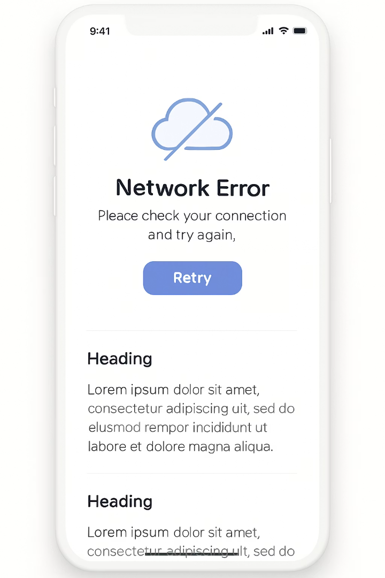





Handling Asynchronous Operations
Identify Async Code
Recognize operations like API calls, file operations, and animations that run asynchronously
Implement Error Handling
Add proper catch blocks or try-catch statements to manage potential failures
Provide Fallbacks
Create alternative paths when operations fail, such as cached data or retry mechanisms
Test Edge Cases
Verify your app handles poor connectivity, timeouts, and service unavailability
Since many operations in React Native are asynchronous, handling errors in these operations ensures the app doesn't break and can provide fallbacks or retries. When network services are unavailable, error handling can allow retry mechanisms, fallback options, or the use of cached data to keep the app functional.

Slide 4
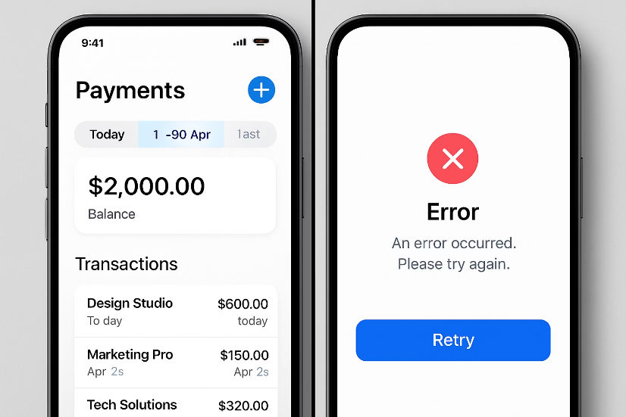
Partial Functionality During Errors
Graceful Degradation
If an error occurs, only certain parts of the app may be affected or disabled without interrupting the overall user experience. This approach maintains core functionality even when specific features fail.
For instance, a game can still function in offline mode without network features, or a social media app can still show cached content when new posts can't be fetched.
Implementing partial functionality requires thoughtful architecture that isolates components and features, allowing them to fail independently without cascading effects throughout the application.

Slide 5
Common Syntax Errors
Unexpected Token Errors
JSX Syntax Issues
Module Not Found Errors
Occur when there are missing curly braces, parentheses, or misplaced commas in your code. These errors are typically caught during compilation and prevent your app from running.
Happen when you forget to close tags or use invalid JSX syntax. React's strict requirements for properly formatted JSX can lead to errors that break your component rendering.
Occur due to incorrect module paths during import statements. These errors indicate that React Native cannot locate a specified file or package that your code is trying to use.
Syntax errors occur due to mistakes in the code syntax and are typically highlighted in the IDE. Modern development environments can help identify these issues before they cause problems at runtime.

Slide 6




Runtime Errors in React Native
Reference Errors
Type Errors
Platform-Specific Errors
Thrown when a variable is used before being declared. These errors occur during execution and can crash your app if not properly handled.
Occur when an operation is performed on an incompatible data type, such as trying to access properties of undefined objects or calling methods on null values.
Arise when using features or APIs that aren't supported on a particular platform, requiring platform checks and conditional code execution.
Runtime errors happen while the app is running, potentially crashing or freezing it. These errors are often more challenging to debug as they may only occur under specific conditions or user interactions that weren't anticipated during development.

Slide 7
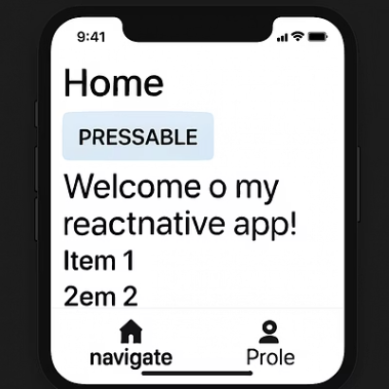
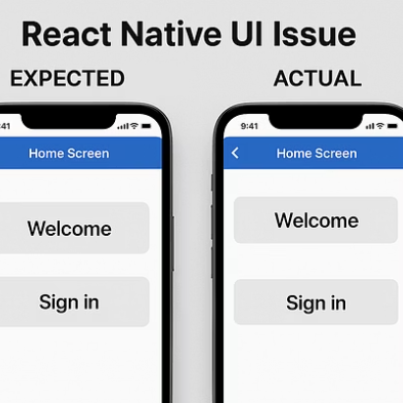


Style and Layout Errors
Style and layout errors affect the UI and are typically identified visually. These include invalid style property errors, which occur when using an unsupported style property, such as with auto, in cases where it's not allowed.
Unexpected behavior is another common issue, which is a layout issue caused by incorrect dimensions or improper use of flexbox properties. These errors can be particularly challenging as they may not trigger explicit error messages but result in visual inconsistencies.

Slide 8








Dependency and Network Errors
Incompatible Libraries
Native Module Linking
Issues that occur when upgrading or adding libraries with mismatched versions, causing conflicts in your application.
Problems when accessing native device features like camera or geolocation, due to improper linking or configuration.
CORS Issues
Failed to Fetch
Occur when making API requests to a different domain without the right permissions, blocking data access.
Caused by an unreachable server, incorrect API endpoint, or network connectivity issues.

Slide 9



Try-Catch Block Implementation
Identify Error-Prone Code
Recognize sections that might throw exceptions
Wrap in Try Block
Enclose risky code in protective try statement
Handle in Catch Block
Implement recovery or fallback logic
Try-catch blocks are useful for catching synchronous errors or exceptions in JavaScript, preventing the app from crashing. You can wrap potentially error-prone code in a try block and handle any errors in the catch block, providing graceful fallbacks or user notifications.
This approach is particularly valuable for operations that might fail due to unexpected input values, mathematical operations that could result in invalid calculations, or when working with potentially malformed data.

Slide 10






Component Error Handling
Validate Props & State
Verify data before using it
Implement Default Values
Provide fallbacks for missing data
Add Conditional Rendering
Display appropriate UI based on data state
Component error handling checks props, states, or values before using them to prevent null or undefined access issues, ensuring the app doesn't crash. For example, if the user is null or undefined, the app will display "user not found" rather than crashing.
This approach creates more robust components that can handle a variety of data states and edge cases, improving overall application stability and user experience.

Slide 11
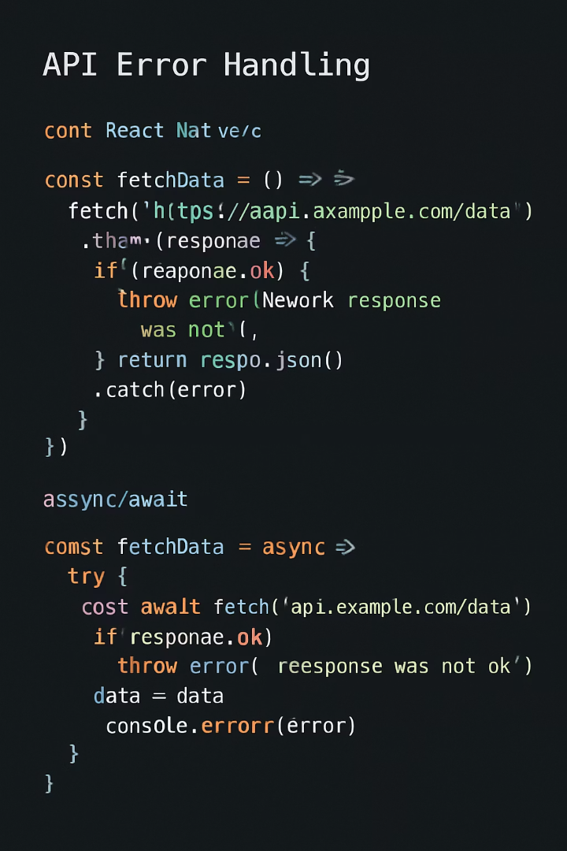




Handling API Errors
Promise-Based Approach
Use .catch() to handle errors in promise chains when making API requests. This approach works well with fetch and other promise-returning functions.
Async/Await Pattern
Wrap await statements in try-catch blocks for more readable asynchronous error handling, making the code flow more like synchronous operations.
Network Status Monitoring
Implement NetInfo to detect connectivity changes and adjust app behavior accordingly, preventing errors before they occur.
Retry Mechanisms
Add exponential backoff strategies to automatically retry failed requests, improving resilience against temporary network issues.

Slide 12

Console Logging for Debugging
1
Strategic Placement
2
Enhanced Logging
3
Object Inspection
Insert console.log statements at key points in your code to track execution flow and variable values. This helps identify where errors occur and what data might be causing them.
Use console.warn for potential issues and console.error for critical problems. These create visually distinct log entries that stand out in your debugging console.
Log complete objects with console.log(JSON.stringify(object, null, 2)) to see nested properties and complex data structures in a readable format.
While not a formal error-handling mechanism, console logging can help debug issues by tracking errors or behavior during development. It's a simple and effective way to identify where an error occurs and understand the state of your application at that moment.

Slide 13
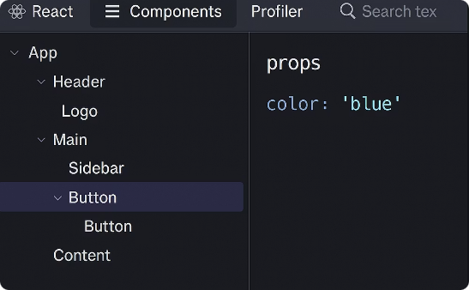
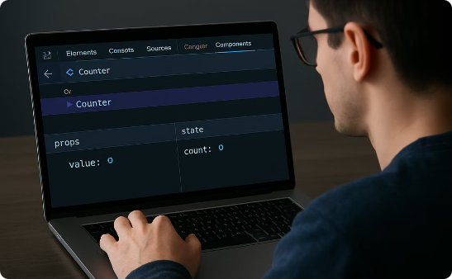
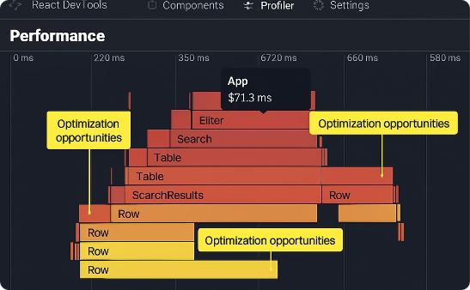
React DevTools for Debugging
Component Inspection
Props & State Monitoring
Performance Profiling
React DevTools allow you to inspect React component trees, examining the hierarchy and relationships between components. This helps identify which components might be causing rendering issues or performance problems.
Monitor props and state changes in real-time to understand how data flows through your application. This is invaluable for tracking down issues related to unexpected component behavior.
Use the Profiler tab to identify performance bottlenecks and unnecessary re-renders. This helps optimize your application by highlighting components that render too frequently or take too long to render.

Slide 14
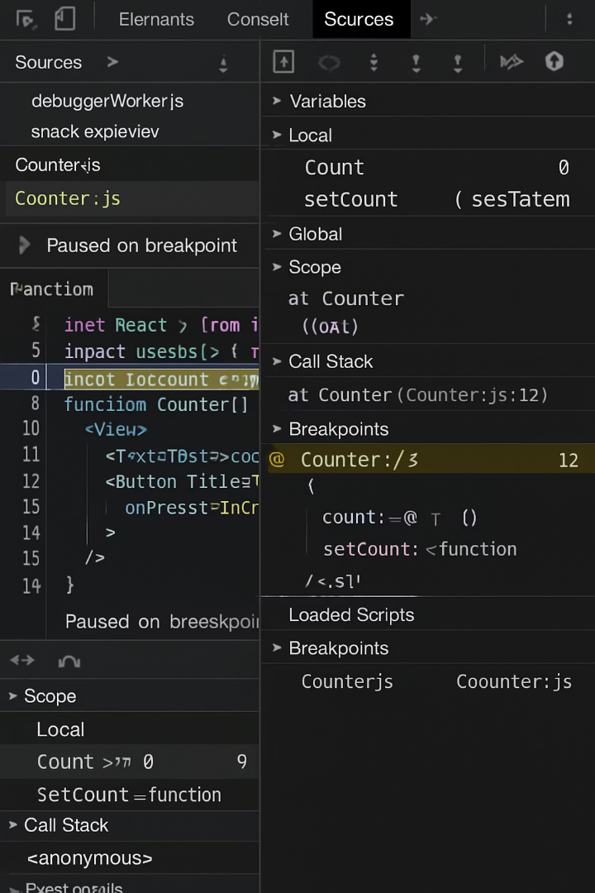
Chrome and VS Code Debugging Tools
100%
50+
Chrome DevTools Coverage
VS Code Extensions
Inspect elements, evaluate code, monitor network requests, and debug JavaScript within the browser when running React Native apps in development mode.
The React Native Tools extension provides specialized debugging features directly in your editor, with breakpoints, variable inspection, and step-through debugging.
2x
Debugging Efficiency
Using these integrated tools can more than double your debugging speed compared to relying solely on console logs and manual inspection.
Chrome DevTools are built-in debugging tools used when running React Native apps in development mode. Visual Studio Code's debugger provides built-in debugging support for JavaScript and React Native code, creating a seamless development experience.

Slide 15
Key Takeaways
Error handling is crucial for stability, maintainability, and user experience in React Native apps. It prevents crashes, maintains app functionality during issues, and ensures a seamless user experience.
We covered various types of errors including syntax, runtime, style/layout, dependency, and network errors.
We explored common strategies for error handling such as try-catch blocks, component-level checks, API error handling, and console logging for debugging.
We examined powerful debugging tools including React DevTools, Chrome DevTools, and Visual Studio Code's debugger that can significantly improve your development workflow.

